Slide 1

Sales funnel PRESENTATION

Slide 2

AGENDA
Customer Awareness Journey And Sales Canvas
Visit
Lead
MQL
Sales Canvas
SQL (Sales Qualified Lead)
Opportunity
Customer
Wrap Up

Slide 3
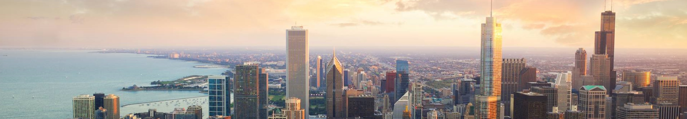
Customer Journey and Sales Canvas

Slide 4

Visit
Customer Journey:
Touchpoints: Website visits, social media interactions, blog reads, ad clicks.
Customer Actions: Browsing content, reading articles, watching videos.
Goals: To attract and engage potential customers.
Metrics: Website traffic, page views, bounce rate, social media engagement.
Sales Canvas:
Activities: SEO optimization, content marketing, social media campaigns, PPC ads.
Tools: Google Analytics, social media analytics, content management systems.

Slide 5
Lead
Customer Journey:
Touchpoints: Newsletter sign-ups, free trial registrations, webinar attendance.
Customer Actions: Providing contact information, engaging with gated content.
Goals: To capture leads and gather contact information.
Metrics: Number of leads, conversion rate from visitors to leads.
Sales Canvas:
Activities: Lead magnets, email marketing, webinars, landing pages.
Tools: CRM systems, email marketing platforms, webinar software.

Slide 6
MQL - (Marketing Qualified Lead)
Customer Journey:
Touchpoints: Email campaigns, targeted content, personalized offers.
Customer Actions: Engaging with emails, downloading resources, attending events.
Goals: To nurture leads and move them further down the funnel.
Metrics: Email open rates, click-through rates, content engagement.
Sales Canvas:
Activities: Lead nurturing campaigns, personalized content, segmentation.
Tools: Marketing automation platforms, CRM systems, analytics tools

Slide 7
SQL (Sales Qualified Lead)
Customer Journey:
Touchpoints: Sales calls, product demos, consultations.
Customer Actions: Requesting demos, engaging with sales reps, asking for quotes.
Goals: To qualify leads and assess their readiness to buy.
Metrics: Number of SQLs, demo requests, sales call outcomes.
Sales Canvas:
Activities: Sales outreach, product demonstrations, consultations.
Tools: CRM systems, sales enablement tools, scheduling software.

Slide 8
Opportunity
Customer Journey:
Touchpoints: Proposal presentations, contract negotiations, final consultations.
Customer Actions: Reviewing proposals, negotiating terms, making decisions.
Goals: To convert qualified leads into opportunities.
Metrics: Proposal acceptance rate, negotiation success rate.
Sales Canvas:
Activities: Proposal creation, contract negotiations, final consultations.
Tools: Proposal software, contract management tools, CRM systems.

Slide 9
Customer
Customer Journey:
Touchpoints: Onboarding, product usage, customer support.
Customer Actions: Using the product, seeking support, providing feedback.
Goals: To ensure customer satisfaction and retention.
Metrics: Customer satisfaction scores, retention rates, customer lifetime value.
Sales Canvas:
Activities: Onboarding programs, customer support, feedback collection.
Tools: Customer support software, feedback tools, CRM systems.
.

Slide 10

Visit: Potential customer discover product through various channel.
Customer journey and sales canvas pyrAMID
Lead: Visitors provide their contact information by signing up for newsletters, free trial or webinars
MQL: Leads engage with target content and personalized offers, showing interest in our product
SQL: Leads request demos, engage with sale reps, and show readiness to buy
Opportunity: leads review proposals, negotiate termqualifieds, and make purchasing decisions
Customer: Customers use the product, seek support, and provide feedback

Slide 11
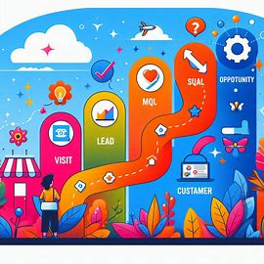
CUSTOMER JOURNEY
Visit: Attract potential customers through various channels like your website, social media, and ads. Goal: Engage visitors.
Lead: Capture contact information through sign-ups for newsletters, free trials, or webinars. Goal: Gather leads.
MQL (Marketing Qualified Lead): Nurture leads with targeted content and personalized offers to show interest in your product. Goal: Move leads further down the funnel.
SQL (Sales Qualified Lead): Qualify leads by assessing their readiness to buy through demos and sales interactions. Goal: Identify potential buyers.
Opportunity: Convert qualified leads into opportunities by presenting proposals and negotiating terms. Goal: Secure purchasing decisions.
Customer: Ensure customer satisfaction and retention through onboarding, product usage, and support. Goal: Maintain and grow customer relationships.

Slide 12
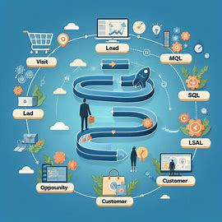
Sales funnel
Awareness
Interest
Consideration
Intent
Evaluation
Purchase
Notes:
Awareness – The top of the funnel where potential customer first learn about product or service. Typicaly happens through marketing efforts like ads, social media, or word of mouth
Interest:- Prospects show interest in product. They might visit website, sign uo for newsletter or follow us on social media
Consideration:- Prospects are now considering buying product or service as a potential solution to their problem. They might compare competitors at this stage.
Intent:- This stage indicates that prospects are leaning towards making a purchase.
Evaluation:- Prospects are making their final decision at this point. They might negotiate terms, seek approval or look for any last-minute reassurances.
Purchase:- The final stage where prospect becomes a customer by completing the purchase

Slide 13
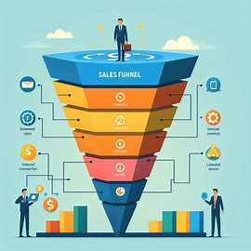
SUMMARY
Visit:
Attract potential customers through various channels. Goal: Engaging visitors.
Lead:
Capture contact information through sign-ups. Goal: Gather leads
MQL:
Nurture leads with targeted content ad personalized offers Gola: Move leads further down the funnel
SQL:
Qualify leads by assessing their readiness to Goal: Identify potential buyers
Opportunity:
Covert qualified leads into opportunities Goal: Secure purchasing decisions
Customer:
Ensure customer satisfaction and retention. Goal: Maintain and grow customer relationships

Slide 14

THANK YOU
Tito Alabi
bolalabi96@gmail.com

